Slide 1

Heart attack prediction using Multi-Modal technique
By
Harsh Prajapati 120CS0206
Department of Computer Science & Engineering National Institute of Technology, Rourkela, Odisha - 769008
Supervisor: Prof. Ratnakar Dash

Slide 2
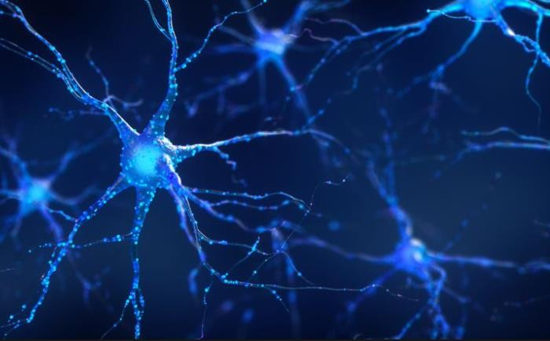
INTRODUCTION
Our brain has a vast network of approximately 86 billion neurons interconnected in an intricate web of synaptic connections.
Neuroplasticity: the brain's ability to rewire itself in response to experience, is particularly prominent during critical periods of development, but it persists throughout life.
https://www.verywellhealth.com/

Slide 3
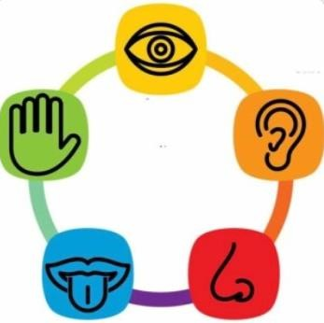
Research problem
Humans use five senses to experience and interpret the world around them
Your five senses capture information from five different sources, and five different modalities. A modality refers to the way in which something happens, is experienced, or captured.
AI is on a quest to mimic the human brain.
https://www.baamboozle.com/tag/five-senses

Slide 4
Multi-Modality
By combining different modalities, a deep learning model can comprehend its environment more universally since some cues exist only in certain modalities.
Unimodal deep learning has limited capabilities, so the need for multimodal models arises.
In multimodal deep learning, the most typical modalities are visual (images, videos), textual, and auditory (voice, sounds, music).

Slide 5
Multi-Modality
Multimodal architectures usually consist of three parts:
Unimodal encoders that encode individual modalities. Usually, one for each input modality.
A fusion network that combines the features extracted from each input modality, during the encoding phase.
A classifier that accepts the fused data and makes predictions.

Slide 6
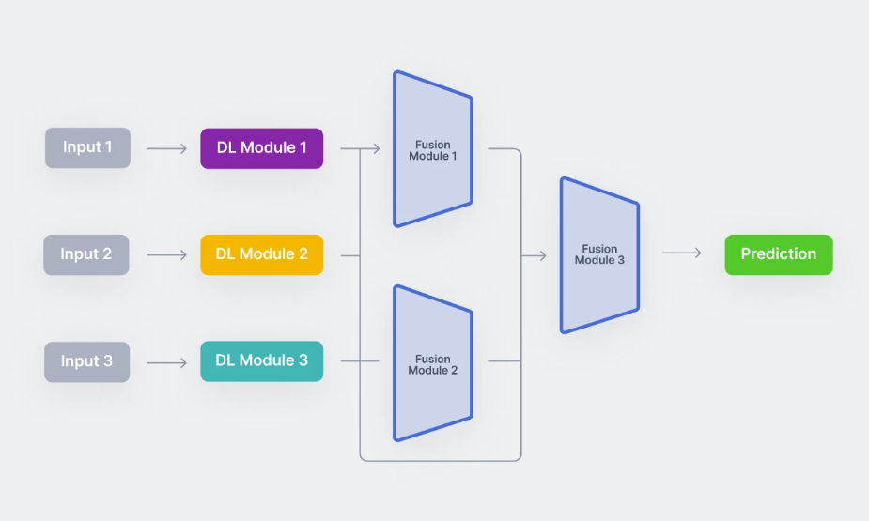
Multi-Modality in deep learning
https://www.v7labs.com/blog

Slide 7
Literature review
Multimodal learning using convolution neural network and Sparse Autoencoder
In this study, they created a system to classify patterns using a combination of convolutional neural networks (CNN) and sparse autoencoders (SAE), bringing together information from MRI and FDG-PET scans. Their main goal was to compare this fusion approach with using each scan alone, emphasizing the benefits of combining different types of information. The experiments showed that the method effectively captures local 3D patterns from both MRI and FDG-PET, and it significantly improves the accuracy of Alzheimer’s disease prediction compared to using each scan separately. This improvement was observed in both the fusion of modalities and when using CNN with pretraining from SA
Multimodal Deep Neural Network with Image Sequence Features for Video Captioning
This research paper focuses on the challenge of automatically describing video clips. The authors compare the effectiveness of a model called S2VT with a recently proposed approach called NeuralTalk2 for image captioning. While effective, S2VT sometimes produces inaccurate sentences, possibly due to limited data. To address this, the authors integrate S2VT with NeuralTalk2 to create MDNNiSF, aiming to improve accuracy by leveraging additional image caption data. The paper suggests that combining these approaches can enhance video captioning accuracy and presents experimental results using Microsoft Research datasets.

Slide 8
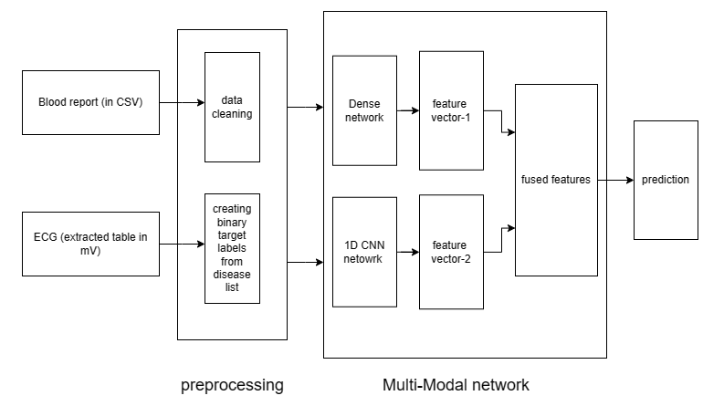
Proposed approach
Flow chart of the model

Slide 9
Proposed approach
Blood Pressure Cholestrol level Chest pain type Fasting blood sugar .
. .
Heart rate Imbalance in compression Chances of arrythmias . .
Fusion
Prediction
Blood report
ECG signals
Extracted feature vector

Slide 10
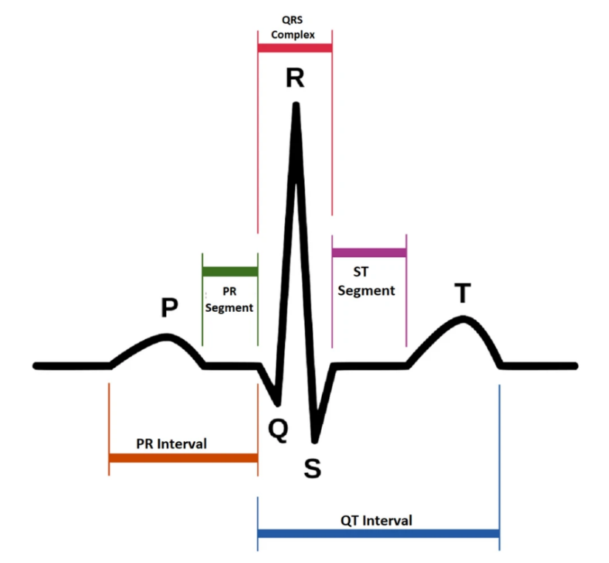
Methodology
The ECG dataset has been processed to extract the signals in a table containing the peaks (in mV), areas and slopes of the signals.
The dataset has 783 columns.
The dataset has various columns such as p_peaks, r_peaks, p_area, q_area, etc.

Slide 11
Methodology
But all these features may not contribute to the target required
Or in other words, some of the features were correlated
Correlation matrix showed that
out of 783 features, ~ 50 of them were providing new information.
Hence highly correlated features were removed.

Slide 12
Methodology
Number of records | Class | Description
7185 | NORM | Normal ECG
3232 | CD | Myocardial Infarcation
3064 | STTC | ST/T Change
2936 | MI | Conduction Disturbance
815 | HYP | Hypertrophy
The target file for this dataset contains the list of diseases in abbreviated format.
For example
”[’NSR’, ’LVH3’, ’LPAREN’, ’RAVL’, ’COMMA’, ’CORNPROD’, ’RPAREN’, ’NST’, ’AB’],”
ECG Signal Classification Using Deep Learning Techniques Based on the PTB-XL Dataset - PMC (nih.gov)

Slide 13
Methodology
Target | More than 2 classes of abnormality | Modified target
[ CD, STTC,MI ] | Yes | 1
[ CD, STTC,MI,HYP ] | Yes | 1
[ NORM,MI ] | No | 0
A list of five diseases were made after analysis and the target was set to 1, if the person contained any 3 or more of those diseases.

Slide 14
But key part is Fusion of those features!!
Methodology
Feature extraction from heterogeneous data in a way that exploits the relation between them is very hard.
Fusion is the task of joining information from two or more modalities to perform
a prediction task.
Effective fusion of multiple modalities, such as video, speech, and text, is challenging due to the heterogeneous nature of multimodal data.

Slide 15
Concatenating feature vectors is indeed a straightforward method for combining different types of features. However it can lead to a significant increase in dimensionality, which in turn can exacerbate overfitting issues, especially if the dataset is not sufficiently large. But in our case the the vectors are in numeric formats and the dimensions are not larger than the data points. So normalization and concatenation of feature vectors works well.
Methodology
f1, f2, f3, f4, f5
f1, f2…f5, g1, g2..g4
Normalized
N (f1, f2…f5, g1, g2..g4)
g1, g2, g3, g4

Slide 16
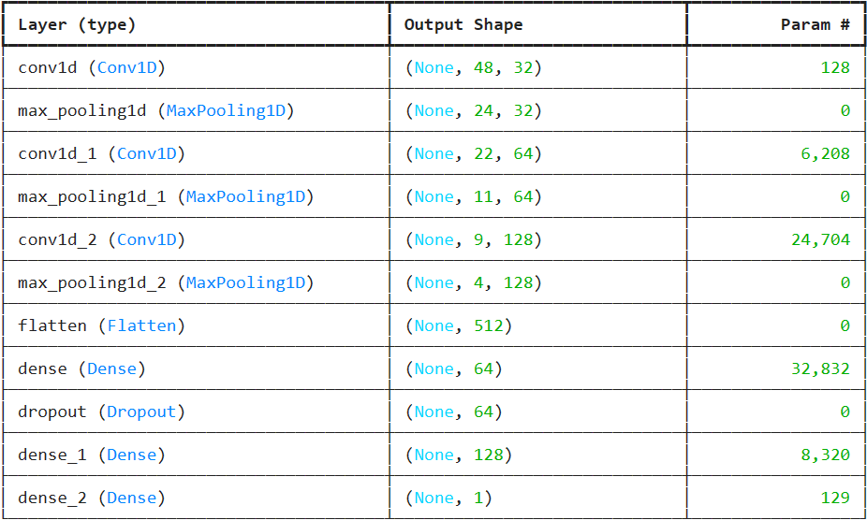
Methodology
Model for ECG dataset

Slide 17
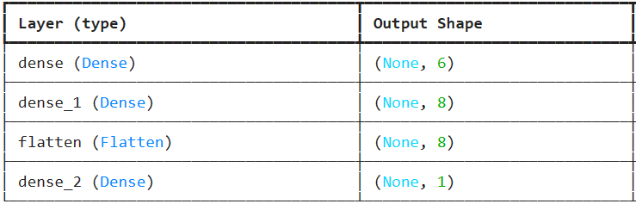
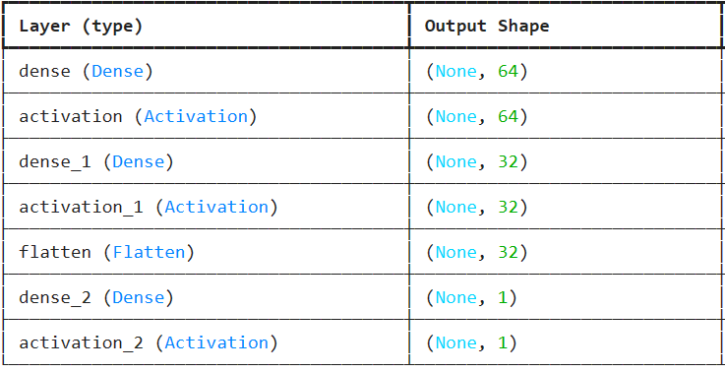
Model for Blood dataset
Methodology
Fusion layer model

Slide 18
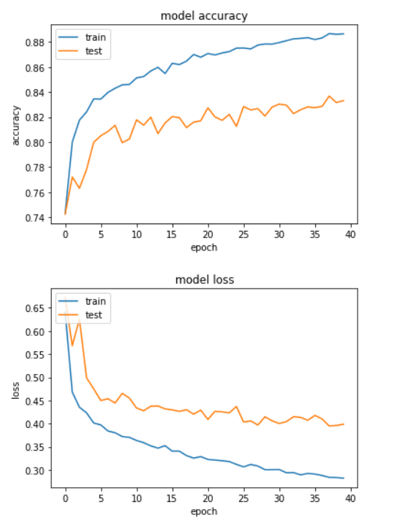
Results and Discussion
The blood report model was trained with the data and showed an accuracy of 89.7% on training set and 82% on testing set.
The ECG processed data was passed in the convolution network model that showed an accuracy of 85% on training set and 79% on testing set.
The multimodal function which can take both the inputs together was trained on the both the data and showed an training accuracy of 89.2% and testing accuracy of 85%.
Training and validation loss for CNN + dropout

Slide 19
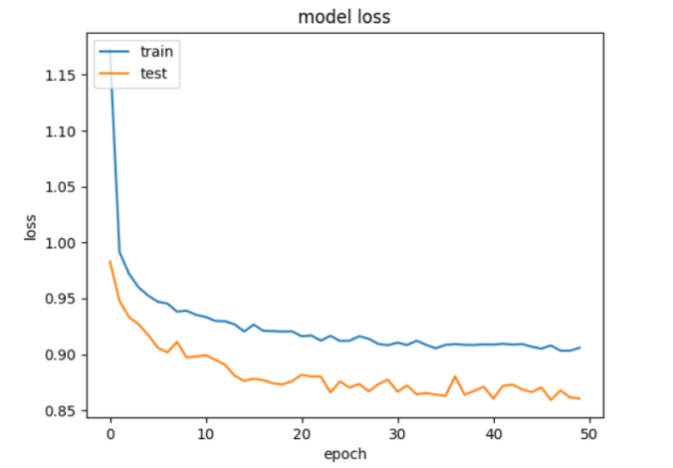
Results and Discussion
Training and validation loss for feature-reduced CNN

Slide 20
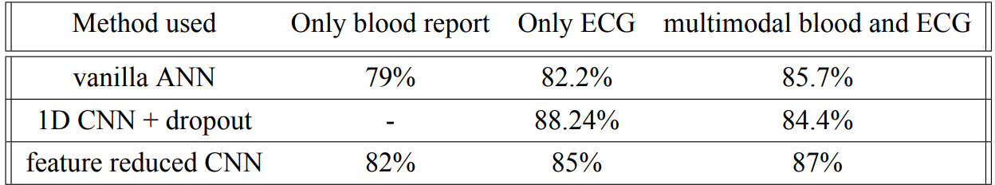
Results and Discussion
The feature reduced CNN network had an accuracy of 87%.
The accuracy can be improved by using paired dataset and adding rows to the data

Slide 21
Conclusion
This project introduces a pioneering approach to predicting heart disease utilizing a multi-modal neural network architecture capable of processing diverse inputs.
By integrating blood report data stored in .xlsx format with feature-extracted electrocardiogram (ECG) data, the model demonstrates versatility in handling various input combinations. The ability to accommodate both individual and combined inputs enhances the model’s flexibility and predictive accuracy.

Slide 22
References
Prakoso, S. D., Permanasari, A. E., and Pratama, A. R., 2023. “Heart disease prediction using machine learning: A systematic literature review”. In 2023 10th International Conference on Information Technology, Computer, and Electrical Engineering (ICITACEE), pp. 155–159. [3]
Oura, S., Matsukawa, T., and Suzuki, E., 2018. “Multimodal deep neural network with image sequence features for video captioning”. In 2018 International Joint Conference on Neural Networks (IJCNN), pp. 1–7. [4]
Vu, T. D., Yang, H.-J., Nguyen, V. Q., Oh, A.-R., and Kim, M.-S., 2017. “Multimodal learning using convolution neural network and sparse autoencoder”. In 2017 IEEE International Conference on Big Data and Smart Computing (BigComp), pp. 309–312. [5] Aziz, S., A. S. . A.“, 2021.”. In ECG-based machine-learning algorithms for heartbeat classification Sci Rep 11, 18738 (2021). [6]
Patel, T. S., Patel, D. P., Sanyal, M., and Shrivastav, P. S., 2023. “Prediction of heart disease and survivability using support vector machine and naive bayes algorithm”. bioRxiv. [7]
Latha, C., and Jeeva, S. C., 2019. Improving the accuracy of prediction of heart disease risk based on ensemble classification techniques, informatics in medicine unlocked, vol. 16.

Slide 23
Thank You

